Slide 1
Final project report
Student: Yermukhanbetov Zh.
Group: SE-2002
Instructor: Kalakova A.

Slide 2

Python library
aiogram is a pretty simple and fully asynchronous framework for Telegram Bot API written in Python 3.7 with asyncio and aiohttp. It helps you to make your bots faster and simpler.

Slide 3

01
Introduction
This bot is made to remind you of something.
Goals
The goals of my project are to create a bot that does not allow me to forget about deadlines when I sit in the telegram

Slide 4
Mindmap
Error
success
Finish
Start
Notify_me
Timer
Help

Slide 5
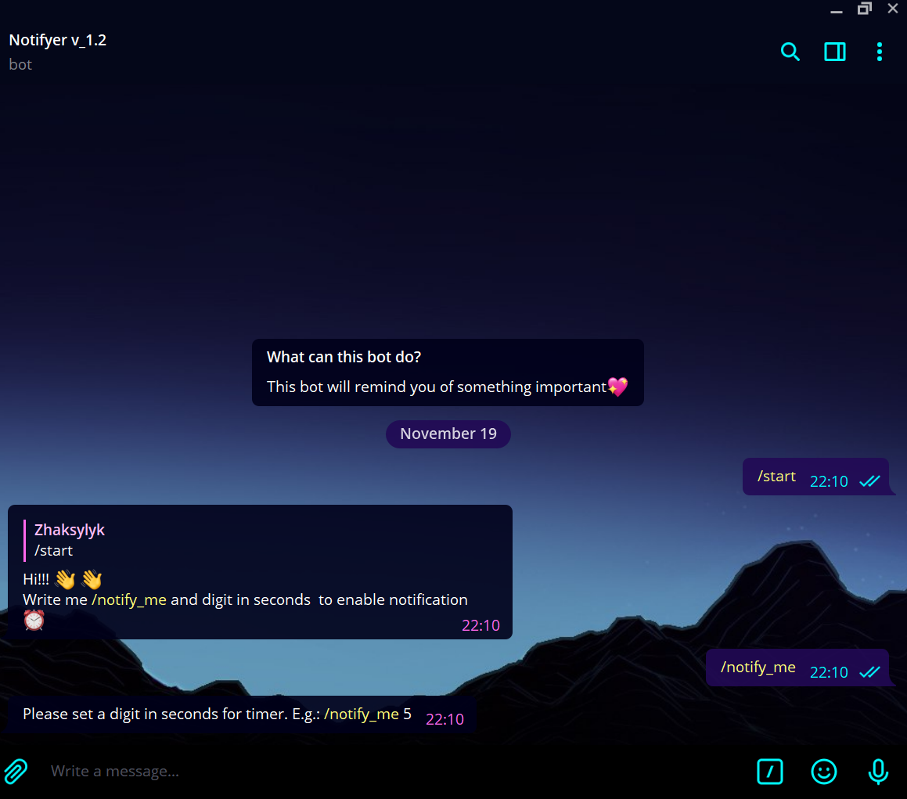
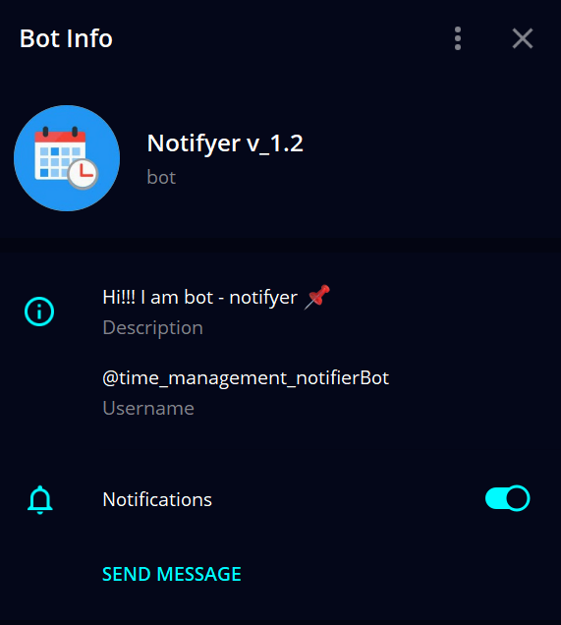

Slide 6

https://github.com/zh4k2y1k/notifyer_telegram_bot

Slide 7
References
https://pypi.org/project/aiogram/
https://docs.aiogram.dev/en/latest/
https://tlgrm.ru/docs/bots/samples

